Slide 1
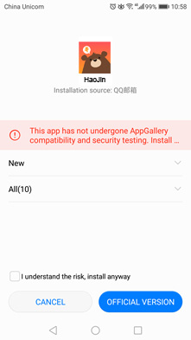
installing the app – android
Once the App is downloaded, you can simply click on the icon or tap ‘OPEN’ to enter the App.
If you see a warning in the pop-up dialog after you open our APP, Please follow several steps to solve this problem.

Slide 2
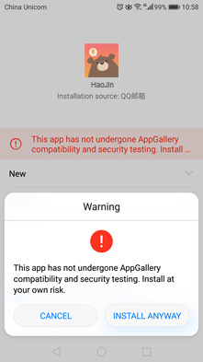
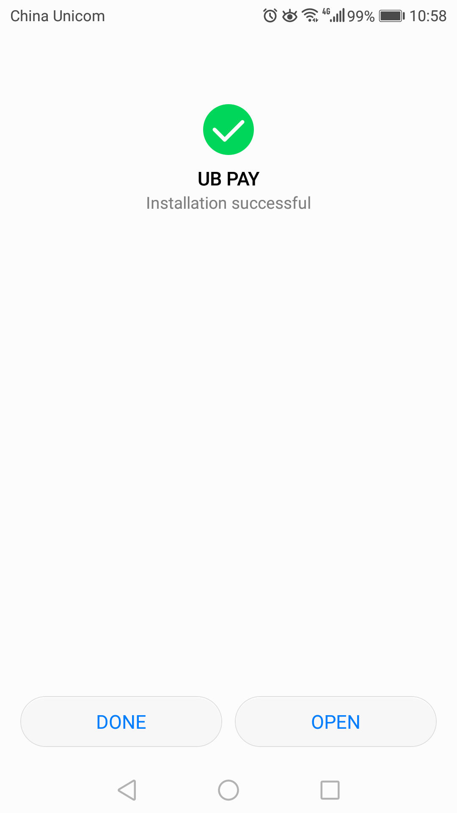
installing the app – android
Step 1
Tick the box of ‘I understand the risk, install anyway’.
Step 2
Tap ‘INSTALL ANYWAY’ in the pop-up dialog.
Step 3
Installation Successful!
Note: UB Pay App is used for illustrative purposes only. The process remains the same for all Merchant Apps and White Label Apps powered by QFPay International.

Slide 3
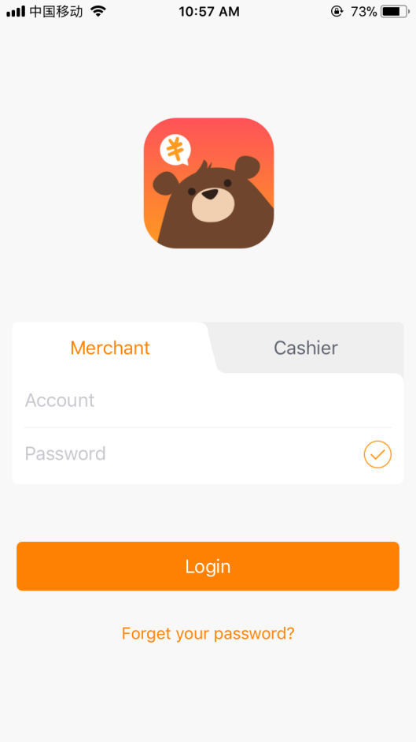
Use the app – merchant login
Enter your account number HERE
Enter your account password HERE
Click Login

Slide 4
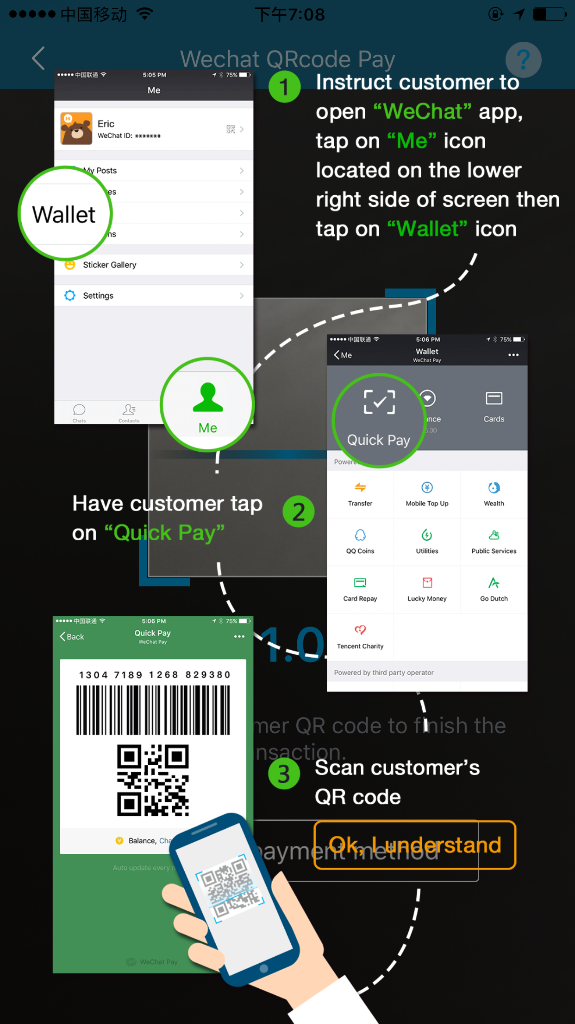
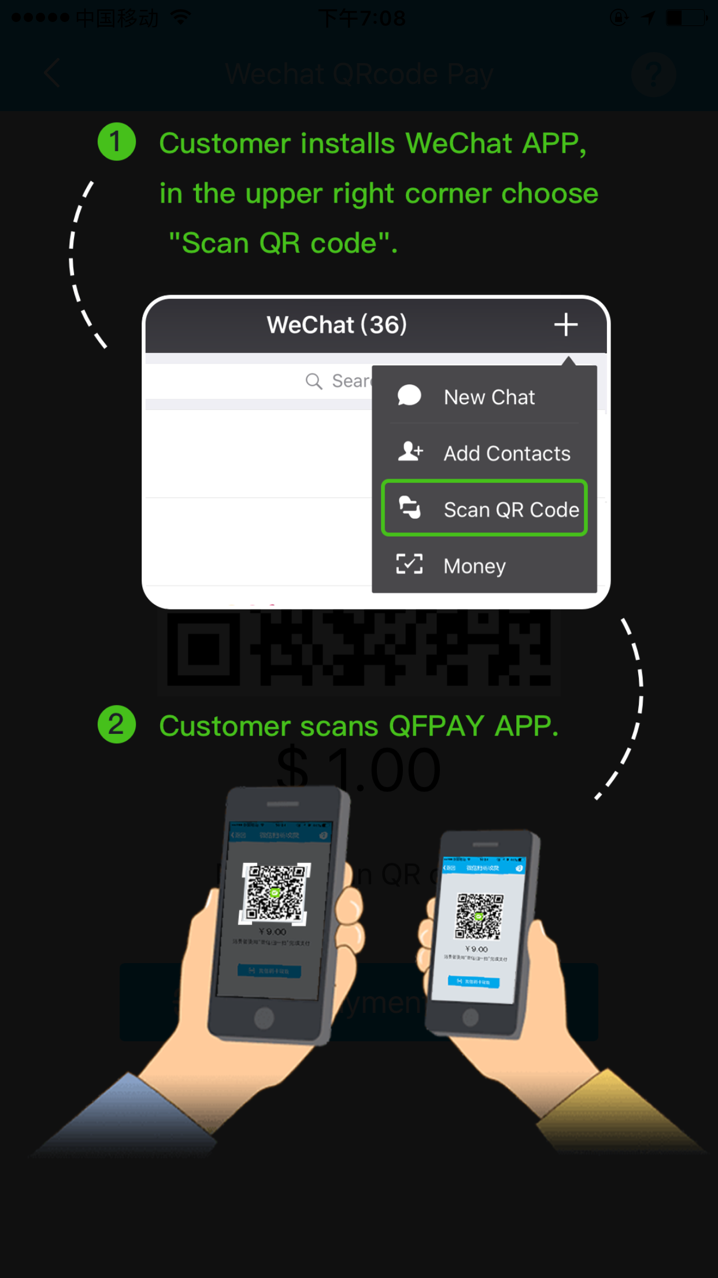
Use the app – merchant login
For first time user, the app provide an auto pop-up instruction page which shows QR-Code scanning process.
WeChat QR code can be found by following the steps below:
Open WeChat APP
Go to “Me” on the right bottom of your WeChat once its open
Press the “Wallet” below the customers’ detail (Name & Display Picture)
Press on “Money” and enter either the “Pin code” or press “OK” to view the QR Code.
Scan this QR Code for payment

Slide 5
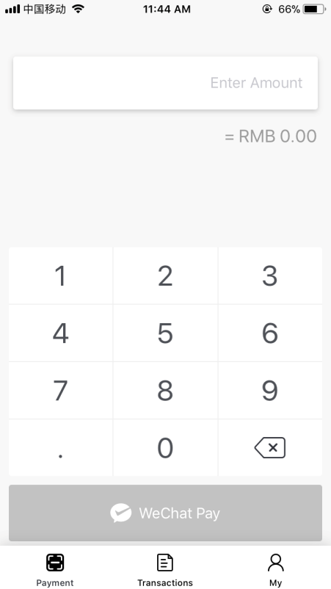
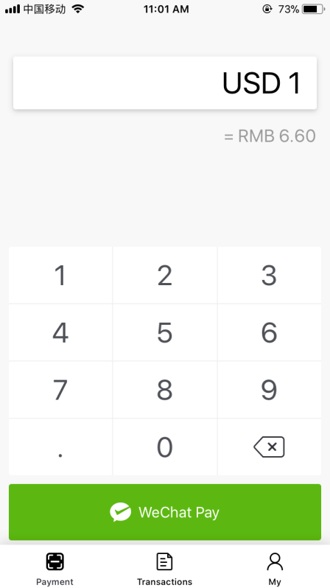
Use the app – payment
After login, you’ll see the home-page as showed on the left
Simply enter amount here, the ‘WeChat Pay’ button turn green
Click ‘WeChat Pay’ to take the payment
Note: The equivalent amount in RMB will automatically appear when payment amount is entered and the “Real-time exchange rates” feature is turned on in the Settings page.

Slide 6
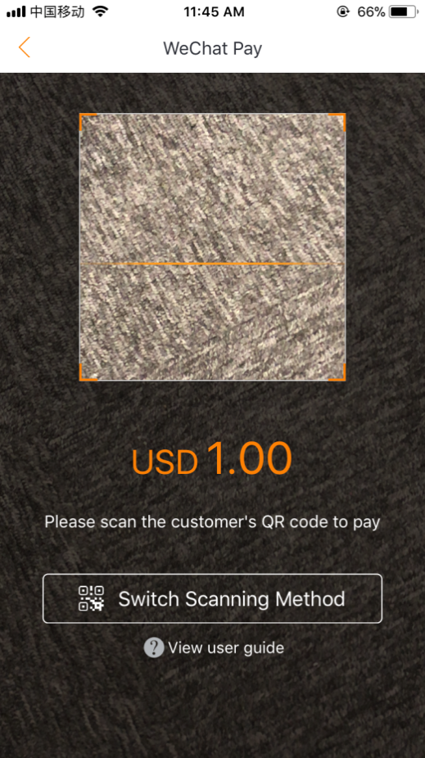
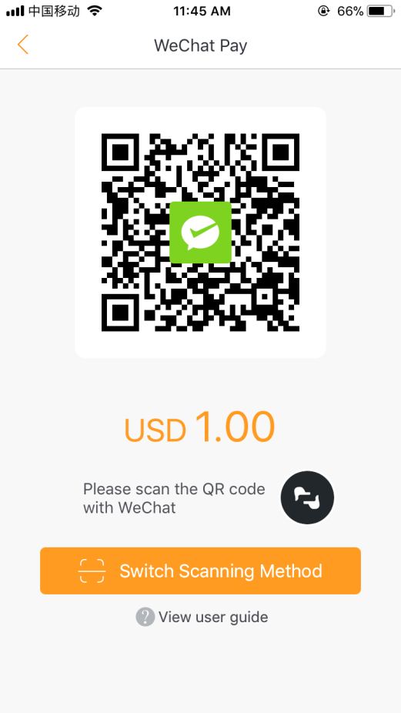
Use the app – payment
2 Mode to Scan
Scan customers’ QR code (Left)
Present store QR code (Right)
Tap this button to
Switch Scan Mode

Slide 7
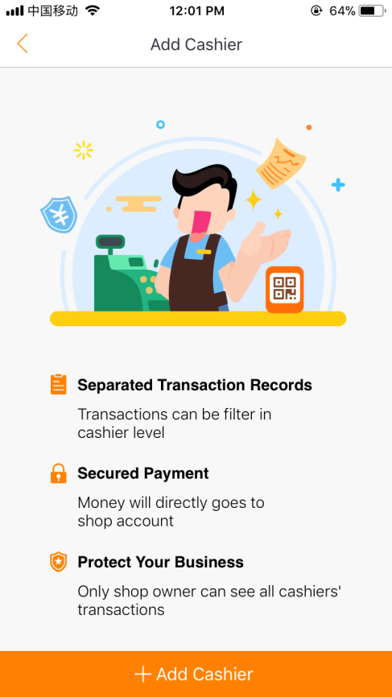
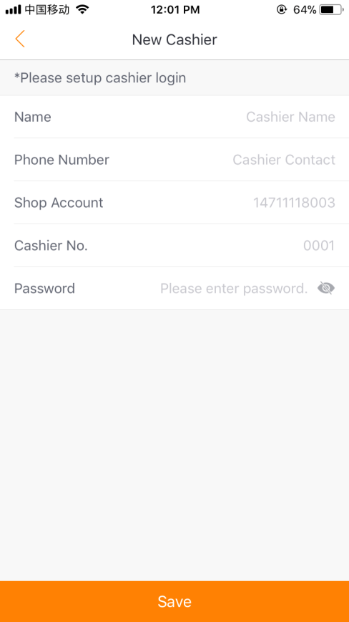
Use the app – Cashier management
Create Cashier Account:
Tap My in the bottom right of the App
Select Cashier Management
Tap Add Cashier
Input Cashier Name, Phone Number and Password
Tap Save to confirm
Note: Shop account and cashier No. are automatically generated by system

Slide 8
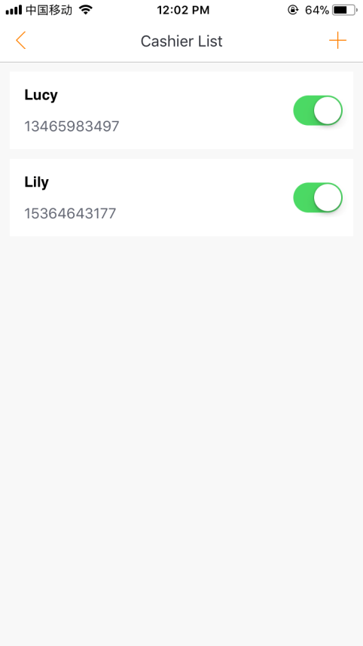
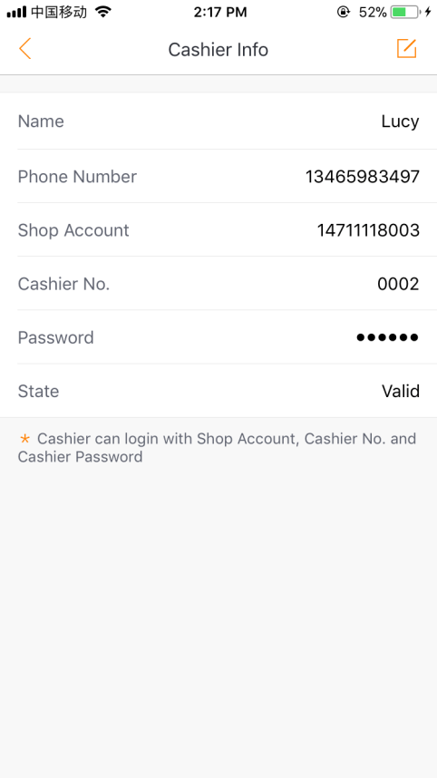
Use the app – Cashier management
Cashier Management:
Tap on Cashier Account Name for more cashier’s detail. Cashier information can be edited by clicking the pencil button
Tap ‘+’ to Add new Cashier
Deactivate/Activate a Cashier account by toggling the button next to their name

Slide 9
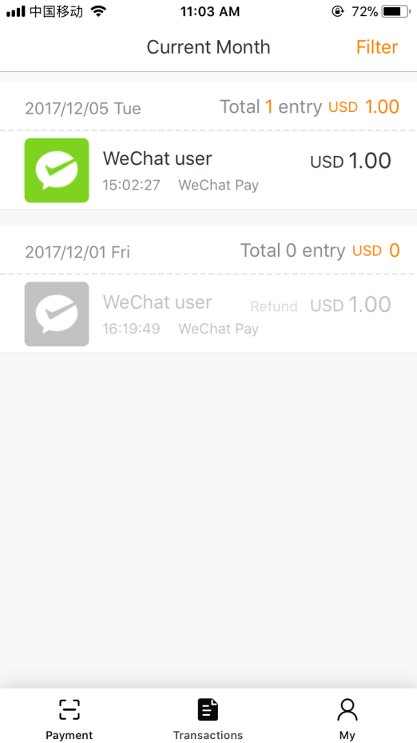
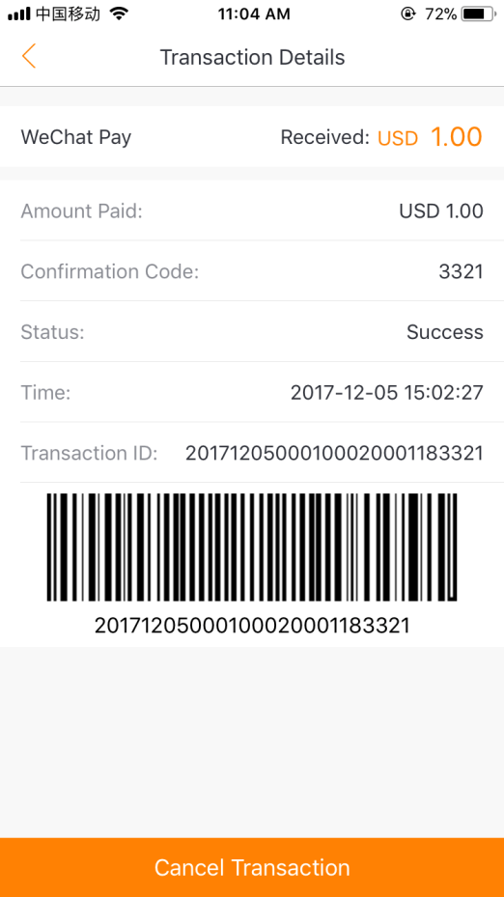
Use the app – Transaction review
Individual Transaction
Tap for more details like:
Transction Amount
Status
Time
Transaction ID
Barcode
Click Transaction to view

Slide 10
Use the app – Transaction review
Click Filter to view Multiply Transactions by select:
Time
Merchant account
Payment method

Slide 11
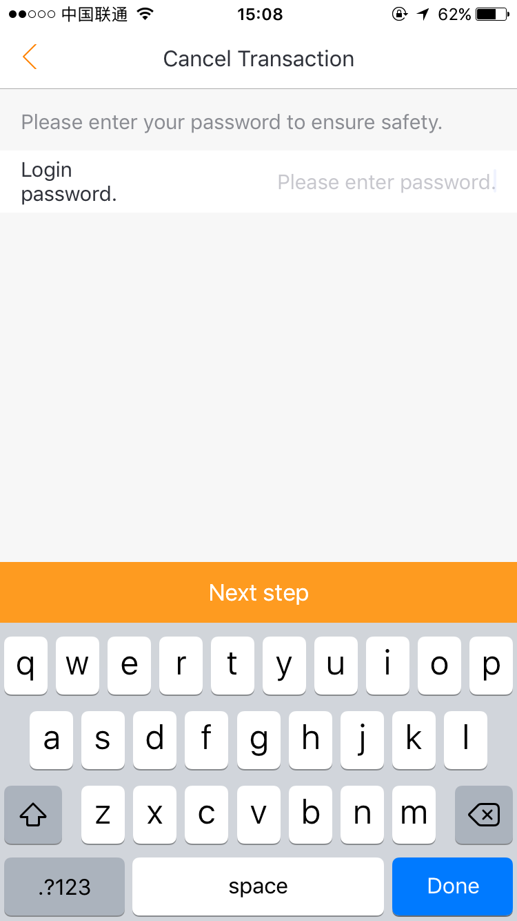
Use the app – transaction refund
Step 2
Tap bottom button to refund
Enter amount to partial refund
Step 1
Tap an individual transaction
Step 3
Enter account password to confirm

Slide 12
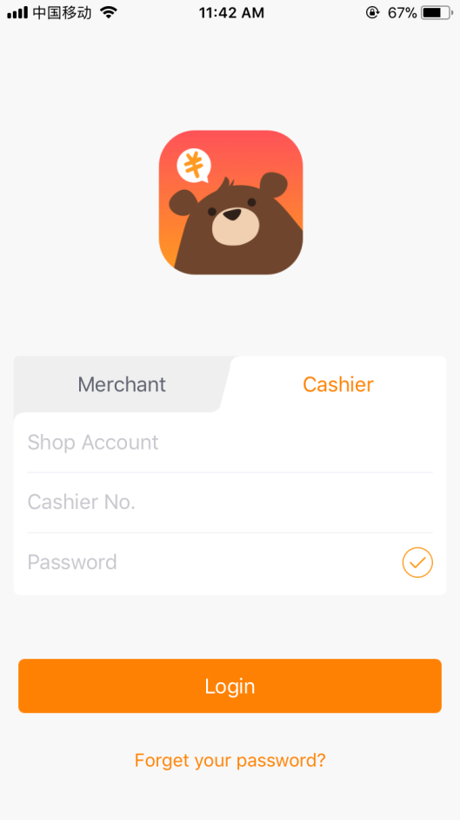
Use the app – cashier login
Notice:
Cashier only could make payment and view transactions make by him/herself, do not have the right to cancel or refund a transaction.
Enter shop account number HERE
Enter cashier No. HERE
Enter cashier password HERE
Click Login

Slide 13
Use the app – Cashier login
For first time user, the app provide an auto pop-up instruction page which shows QR-Code scanning process.
WeChat QR code can be found by following the steps below:
Open WeChat APP
Go to “Me” on the right bottom of your WeChat once its open
Press the “Wallet” below the customer’s detail (Name & Display Picture)
Press on “Money” and enter either the “Pin code” or press “OK” to view the QR Code.
Scan this QR Code for payment

Slide 14
Use the app – Cashier payment
After login, you’ll see the home-page as showed on the left
Simply enter amount here, the ‘WeChat Pay’ button turn green
Click ‘WeChat Pay’ to take the payment
Note: The equivalent amount in RMB will automatically appear when payment amount is entered and the “Real-time exchange rates” feature is turned on in the Settings page.

Slide 15
Use the app – Cashier payment
2 Mode to Scan
Scan customers’ QR code (Left)
Present store QR code (Right)
Tap this button to
Switch Scan Mode

Slide 16

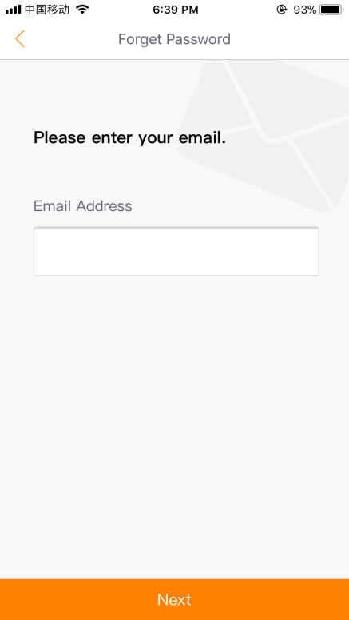
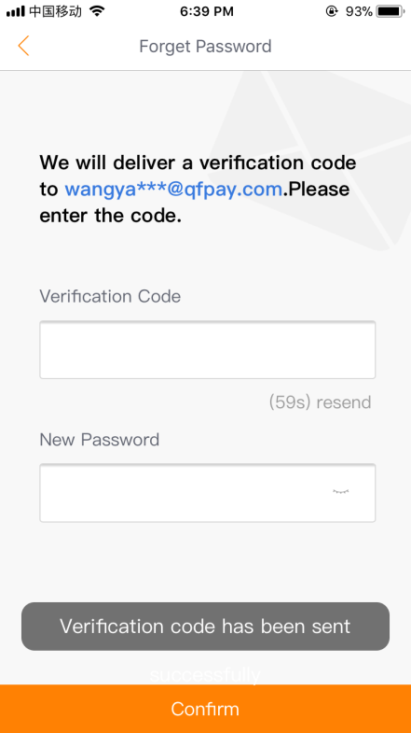
Forget your Password
Reset your password:
Step 1
Tap Forget your password?
Step 2
Enter account email address
Step 3
A verification code will be sent via email. Enter the code and a new password, then tap Confirm to complete.

Slide 17
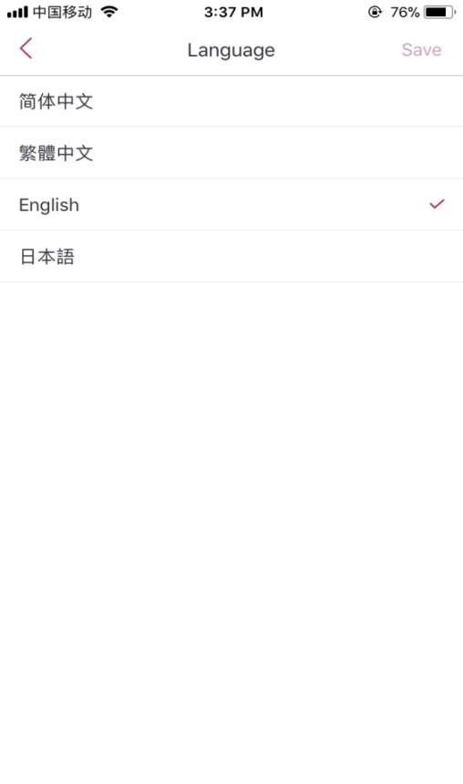
settings
Settings on the ‘My’ page:
Customizable Settings include:
Enabling/Disabling Sound Notifications
Showing/Hiding the barcode
Language selection
Traditional Chinese
Simplified Chinese
English
Japanese
Showing/Hiding real-time exchange rates with the local currency to RMB

Slide 18
THANK YOU
“Connecting the World with Mobile Payment One Country at a Time”

